Slide 1
Statistical Computation Methods for Data Science
By
S U Ravi Kumar Ch
Assistant professor of Mathematics
Department of Science and Humanities
Sreenidhi Institute of Science and Technology
Yamnampet, Ghatkesar.
1

Slide 2
OUTLINE
Measure of central tendency
Mean
Median
Mode
Examples

Slide 3
Measures of Central Tendency
Measure of central tendency are used to describe the middle of a data set.
Mean, median, and mode are some measures of Central Tendency.
Course 3

Slide 4
Characteristics of an ideal measure of central tendency
It should be rigidly defined
It should be readily comprehensible and easy to calculate
It should be based on all observations
It should be suitable for further mathematical treatment.
It should be affected as little as possible by fluctuations of sampling.
It should not be affected much by extreme values.

Slide 5
Measures of Central Tendency
Example 1: Finding Measures of Central Tendency and Range
Find the mean, median and the mode of the data set.
21, 21, 28, 29, 30, 28, 32

Slide 6
Measures of Central Tendency
Example 1: Finding Measures of Central Tendency and Range
Find the mean, median and the mode of the data set.
21, 21, 28, 29, 30, 28, 32
Add the values.
mean:
21 + 21 + 28 + 29 + 30 + 28 + 32 = 189
1897
= 27
Divide by 7, the number of values.
median:
21 21 28 28 29 30 32
Order the values.
The median is 28.
mode:
21, 28
Two values occur twice.
range:
32 – 21 = 11

Slide 7
Measures of Central Tendency
Example 2
Find the mean, median and the mode of the data set.
Measures of Central Tendency
45, 32, 22, 37, 45, 41, 37

Slide 8
Measures of Central Tendency
Example 2
Find the mean, median and the mode of the data set.
Measures of Central Tendency
45, 32, 22, 37, 45, 41, 37
Add the values.
mean:
45 + 32 + 22 + 37 + 45 + 41 + 37 = 259
2597
= 37
Divide by 7, the number of values.
median:
22 32 37 37 41 45 45
Order the values.
The median is 37.
mode:
37, 45
Two values occur twice.
range:
45 – 22 = 23

Slide 9
Example 3: Applications
Employees at a store earned $275, $330, $290, $300, $350, $365, and $310 during one week. What measure of central tendency or range would make the salaries look the highest?

Slide 10
Example 3: Applications
Employees at a store earned $275, $330, $290, $300, $350, $365, and $310 during one week. What measure of central tendency or range would make the salaries look the highest?
Find each measure of central tendency and the range of the data.
mean:
275 + 330 + 290 + 300 + 350 + 365 + 310 = 2220
2220
≈ 317
7
median:
275 290 300 310 330 350 365
mode:
There is no mode.
range:
365 – 275 = 90
The mean makes the salaries look the highest.

Slide 11
Measures of Central Tendency
Example 4
Firemen at a local fire station ran 7, 8, 7, 12, 14, 9, and 10 miles in one week. What measure of central tendency or range would make the number of miles ran look the lowest?
Course 3

Slide 12
Measures of Central Tendency
Example 4
Firemen at a local fire station ran 7, 8, 7, 12, 14, 9, and 10 miles in one week. What measure of central tendency or range would make the number of miles ran look the lowest?
Find each measure of central tendency and the range of the data.
mean:
7 + 8 + 10 + 12 + 14 + 9 + 10 = 70
707
= 10
median:
7 8 9 10 10 12 14
mode:
10
range:
14 – 7 = 7
The range makes the number of miles ran the lowest.
Course 3

Slide 13
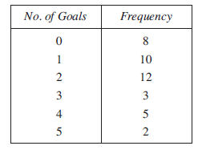
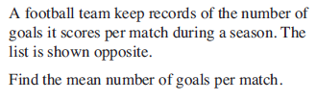
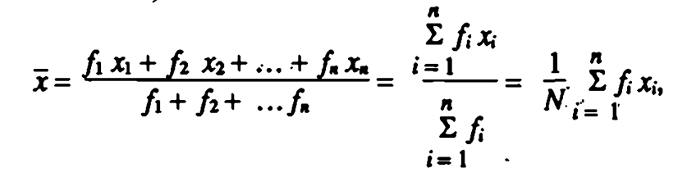
Measures of Central Tendency
Example 5
Formula…
Course 3

Slide 14

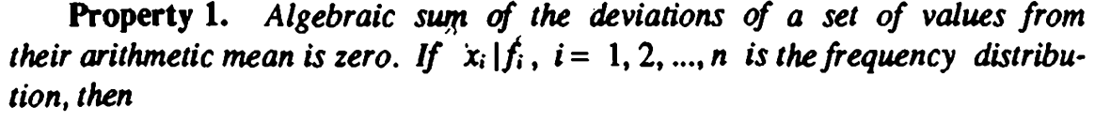
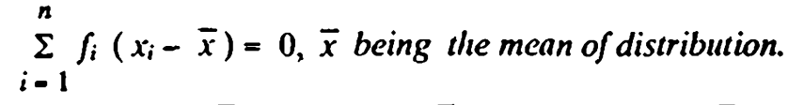
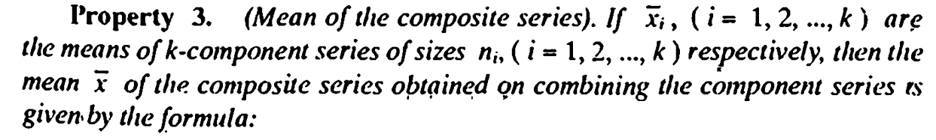
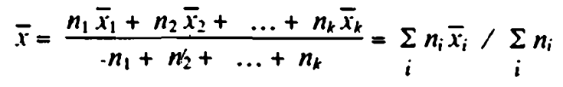

Slide 15
Merits:
It is rigidly defined.
It is easy to understand and easy to calculate.
It is based upon all the observations.
It is amenable to algebraic treatment.
Of all the averages, arithmetic mean is affected least by fluctuations of sampling.

Slide 16
Demerits:
It cannot be determined by inspection nor it can be located graphically.
Arithmetic mean cannot be used if we are dealing with qualitative characteristics which cannot be measured quantitatively, such as intelligence, honesty, beauty, etc. in such cases median is useful.
Arithmetic mean cannot be obtained if a single observation is missing.
Arithmetic mean is affected very much by extreme values.
Arithmetic mean ma lead to wrong conclusions if the details of the data from which it is computed are not given.

Slide 17
Arithmetic mean cannot be calculated if the extreme class is open.
In extremely asymmetrical distribution, usually arithmetic mean is not a suitable measure of location.

Slide 18
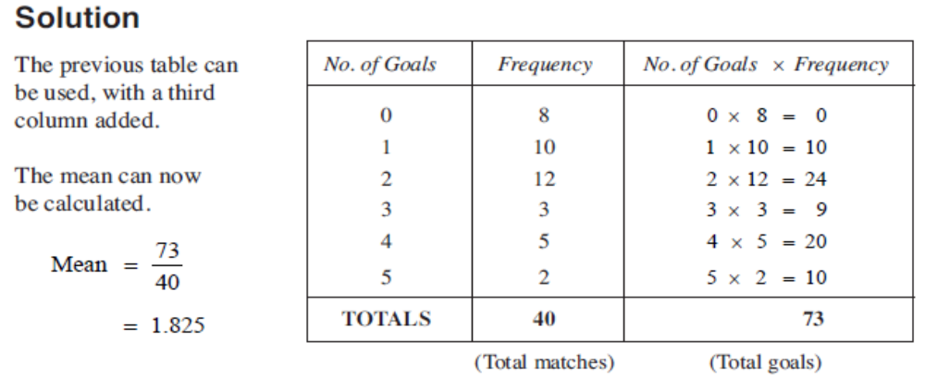
Measures of Central Tendency
Example 5
Course 3

Slide 19
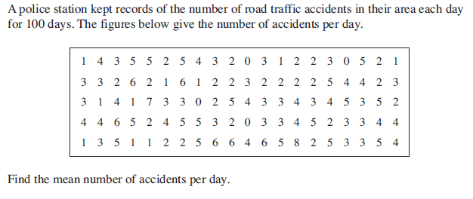
Measures of Central Tendency
Example 6
Course 3

Slide 20
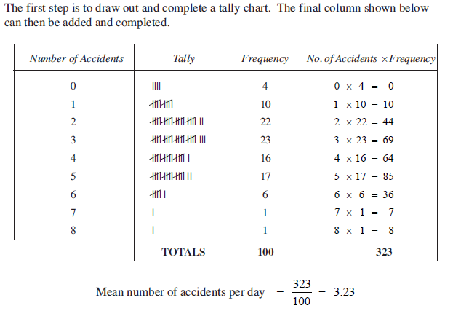
Measures of Central Tendency
Example 6 Solution
Course 3

Slide 21
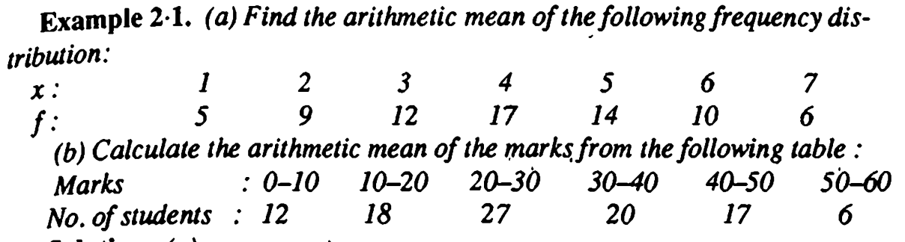
Measures of Central Tendency
Example 7
Course 3

Slide 22
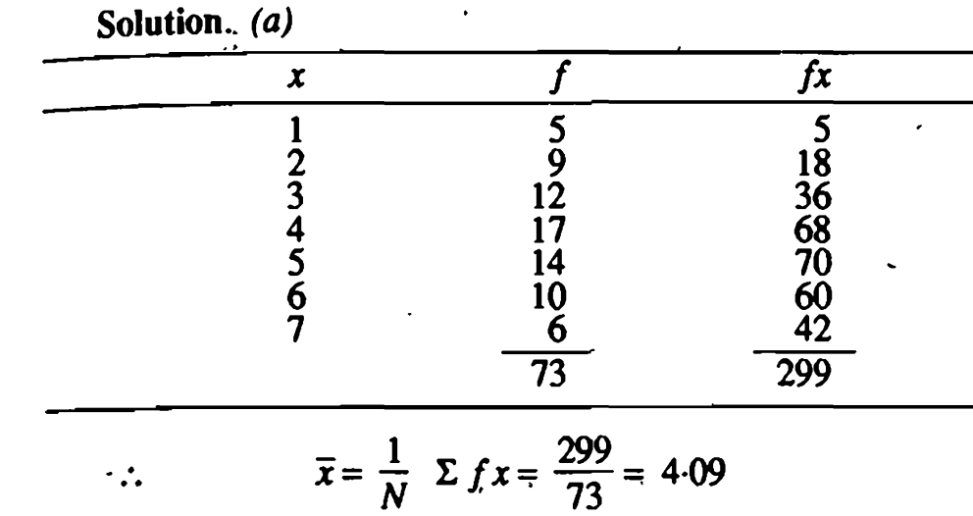
Measures of Central Tendency
Example 7
Course 3

Slide 23
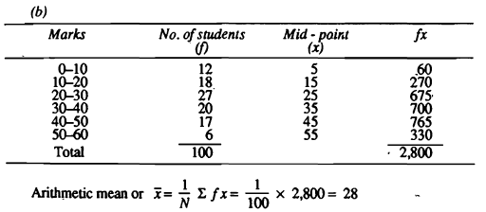
Measures of Central Tendency
Example 7b Solution
Course 3

Slide 24
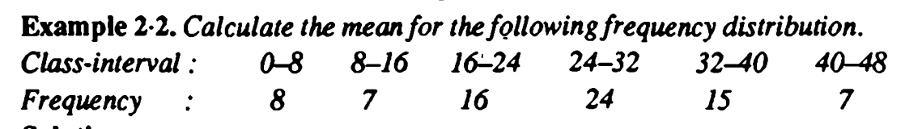
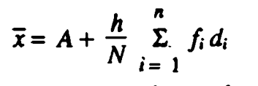
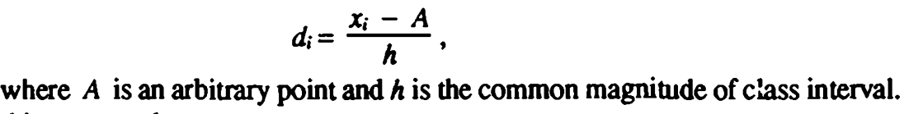
Measures of Central Tendency
Example 8
Course 3

Slide 25
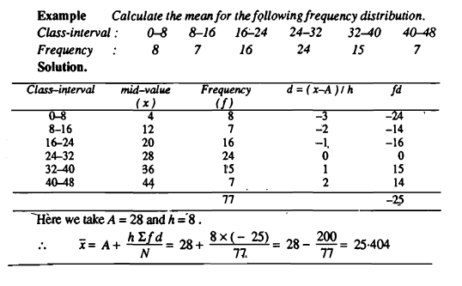
Measures of Central Tendency
Example 8
Course 3

Slide 26
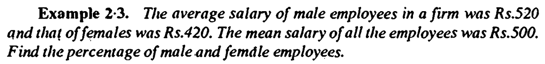
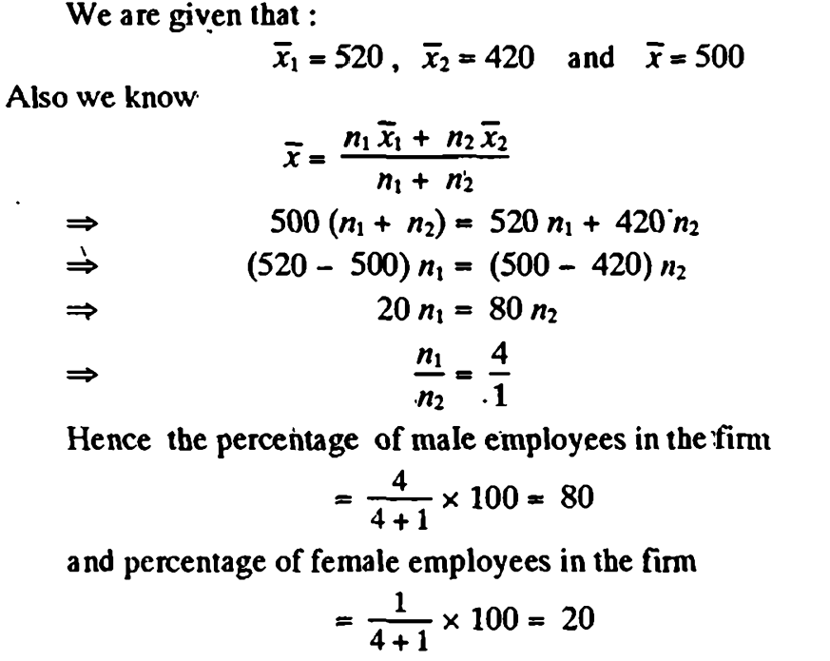

Slide 27
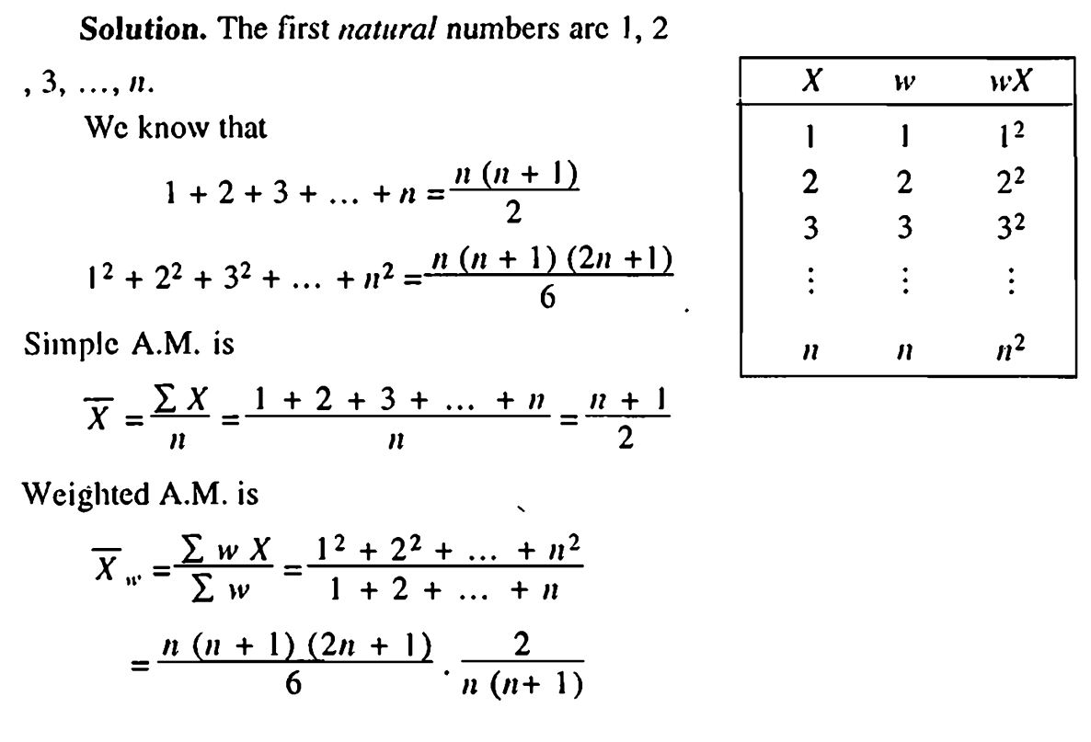

Slide 28
THANK YOU
Feed Back to
ravikumarch@sreenidhi.edu.in

